Slide 1
Enterprise Kafka
Kafka as a Service

Slide 2
Why Am I Here?
You want to find out what this “Kafka” thing is
You’re running Kafka, but you want to go big
You’re looking for some neat whizbangs
Notes:
So why have you decided to spend the next 50 minutes with us? Probably
You’re new to this whole “big data” thing, or at least new to Kafka, and want to get an idea of what it’s all about
You’re running Kafka, but you need to expand and want to learn from someone else’s mistakes
You want to find some neat tools for making your life easier

Slide 3


Clark Haskins
Site Reliability Engineer
LinkedIn
Todd Palino
Site Reliability Engineer
LinkedIn

Slide 4
Who Are We?
Kafka SRE at LinkedIn
Site Reliability Engineering
Administrators
Architects
Developers
Keep the site running, always
Notes:
So who are we, and why are we qualified to stand up here?
We, along with one of our colleagues who is back in Mountain View furiously pushing bytes around, are the Kafka SRE team at LinkedIn
SRE stands for Site Reliability Engineering. Many of you, like us before we started in this role, may not be familiar with the title.
SRE combines several roles that fit together into one Operations position
Foremost, we are administrators. We manage all of the systems in our area
We are also architects. We do capacity planning for our deployments, plan out our infrastructure in new datacenters, and make sure all the pieces fit together
And we are also developers. We identify tools we need, both to make our jobs easier and to keep our users happy, and we write and maintain them.
At the end of the day, our job is to keep the site running, always.

Slide 5
Kafka Overview
Notes:
In this section, we will take a little time to go over Kafka at a high level for those who may be new it.
This will give us a level playing field to work with, and make sure that we’re all using the same terminology.

Slide 6

What Is Kafka?
Notes:
Here’s your first clue – we’re not talking about this guy.

Slide 7

What Is Kafka?
Producer
A
P0
A
P1
A
P0
A
P1
A
P0
Broker
Consumer
Zookeeper
Notes:
Kafka is a publish-subscribe messaging system, in which there are four components:
- Broker (what we call the Kafka server)
- Zookeeper (which serves as a data store for information about the cluster and consumers)
- Producer (sends data into the system)
- Consumer (reads data out of the system)
Data is organized into topics (here we show a topic named “A”) and topics are split into partitions (we have partitions 0 and 1 here).
A “message” is a discrete unit of data within Kafka. Producers create messages and send them into the system. The broker stores them, and any number of consumers can then read those messages.
In order to provide scalability, we have multiple brokers. By spreading out the partitions, we can handle more messages in any topic.
This also provides redundancy. We can now replicate partitions on separate brokers. When we do this, one broker is the designated “leader” for each partition. This is the only broker that producers and consumers connect to for that partition. The brokers that hold the replicas are designated “followers” and all they do with the partition is keep it in sync with the leader.
When a broker fails, one of the brokers holding an in-sync replica takes over as the leader for the partition. The producer and consumer clients have logic built-in to automatically rebalance and find the new leader when the cluster changes like this. When the original broker comes back online, it gets its replicas back in sync, and then it functions as the follower. It does not become the leader again until something else happens to the cluster (such as a manual change of leaders, or another broker going offline).

Slide 8
Attributes of a Kafka Cluster
Disk Based
Durable
Scalable
Low Latency
Finite Retention
NOT Idempotent (yet)
Notes:
When configured using multiple brokers, a Kafka cluster is
Disk Based. It stores messages in log-oriented files on disk, which allows for long retention periods
Durable, as it provides for redundancy of messages and handles a broker failure gracefully
Scalable. We can easily handle more messages in a topic by splitting it into more partitions. We can spread those partitions over as many brokers as needed to handle the traffic.
Provides low latency, in general governed by the speed at which producers and consumers can communicate and process messages
It has finite retention of messages, configurable for the cluster and also per-topic. We retain messages for a week, typically. This means that a message can be produced one time by a producer, and it is retained by the Kafka broker to be consumed by as many consumers as are interested in it.
Also of note is that messages are not idempotent – If a producer repeats a message, it will be present multiple times in the cluster. This is something that the development team is working to change.

Slide 9
Kafka At LinkedIn
Multiple Datacenters, Multiple Clusters
Mirroring between clusters
Message Types
Metrics
Tracking
Queuing
Data transport from applications to Hadoop, and back
Notes:
At LinkedIn, Kafka is part of the core of our distributed data systems.
We have multiple datacenters, and in each datacenter there are multiple clusters, for a total of over 20
We mirror data between the clusters to flow messages through the system
There are three primary types of messages for us
Metrics, which covers everything from OS measurements to application health. These are produced by every system and every service within LinkedIn, and are consumed by a number of monitoring systems.
Tracking, which includes information how long frontend calls are taking and actions that users are performing
Queuing, which is used for coordination in activities like sending out emails.
Much of the tracking information is used by offline data processing, such as Hadoop, to drive applications such as search and recommendations, and we use Kafka to deliver data to Hadoop, and return results back to those applications.

Slide 10

Kafka At LinkedIn
Notes:
At LinkedIn, Kafka is a framework, not a closed system. We, as the SREs, run the Kafka brokers, but we are not in control of the consumers and producers.
This makes the system flexible and open, and it is heavily used in all aspects of what we do. This means a lot of data. How much?

Slide 11
Kafka At LinkedIn
300+ Kafka brokers
Over 18,000 topics
140,000+ Partitions
220 Billion messages per day
40 Terabytes In
160 Terabytes Out
Peak Load
3.25 Million messages per second
5.5 Gigabits/sec Inbound
18 Gigabits/sec Outbound
Notes:
We have over 300 brokers in total in our 20+ clusters
Which are managing over 18,000 topics
With over 140 thousand partitions between them, not including replication
On the typical day, we’re seeing over 220 billion messages being produced
For a total of over 40 terabytes of data. On the consumer side, it’s not as easy to get a clear number of messages
But our consumers are reading in excess of 160 terabytes of messages
And of course, that is compressed data numbers
At peak, we’re receiving over 3 million messages per second
For a total of 5 gigabits per second of inbound traffic
And the consumers are reading 18 gigabits per second at the same time
Again, this is compressed data
Some might be curious how we can consume more data than we produce. This is a feature of Kafka, in that a message that is produced once can be consumed many times, by different applications.
Needless to say, this much data has presented us with some big challenges to overcome

Slide 12
Challenges We Have Overcome

Slide 13
Solutions
Kafka is young…..we Influenced development
Operations wizardry…
Notes:
Kafka is still young
We sit with developers to find solutions for new operational challenges

Slide 14
Hyper Growth
Need to expand clusters to keep up with site traffic, and then balance them.
Notes:
The Internet is getting bigger. LinkedIn is growing. The amount of data that people find useful is growing. We have to keep up with this. Expanding clusters is a must!

Slide 15
Adding brokers
Producers
A
P0
A
P1
A
P2
A
P3
A
P4
A
P5
A
P6
A
P7
Brokers
B
P0
B
P1
B
P2
B
P3
B
P4
B
P5
B
P6
B
P7
C
P0
C
P1
C
P2
C
P3
A
P0
A
P1
A
P2
A
P3
A
P4
a
P5
A
P6
A
P7
B
P0
B
P1
B
P2
B
P3
B
P4
B
P5
B
P6
B
P7
C
P0
C
P1
C
P2
C
P3
Consumers
Notes:
-Cluster expansion previously only used the new added brokers for new topics and partitions
This is an example of a 4 broker Kafka cluster. There are 3 topics shown here with a total of 20 partitions with replication factor of 2. As your Kafka cluster becomes more and more used, there will come a time when you need to increase its capacity. You might want to do this for a number of reasons, you need more storage capacity, you want to add more network capacity. So you add a new broker into the cluster. Unfortunately only new partitions and topics will utilize the new broker. Wait a minute…that doesn’t seem useful.

Slide 16
Adding a broker(with broker leveling)
Producers
A
P0
A
P1
A
P2
A
P3
A
P4
A
P5
A
P6
A
P7
Brokers
B
P0
B
P1
B
P2
B
P3
B
P4
B
P5
B
P6
B
P7
C
P0
C
P1
C
P2
C
P3
A
P0
A
P1
A
P2
A
P3
A
P4
A
P5
A
P6
A
P7
B
P0
B
P1
B
P2
B
P3
B
P4
B
P5
B
P6
B
P7
C
P0
C
P1
C
P2
C
P3
Consumers
Notes:
-Partition Reassignment
-Broker leveling script moves data to even out data volume per broker
As I mentioned when you add a broker to a cluster it won’t be used by existing partitions.
With the 0.8.1 release of Kafka there is a new feature, Partition Reassignment! Now when you add a broker to the cluster, it can be used by your existing topics and partitions! Existing partitions can be moved around live and be completely transparent to all consumers and producers. We have developed a tool sits on top of the partition reassignment tool that will balance a cluster after you add new brokers, or if your cluster is simply unbalanced(there are many ways you can wind up in this state). What it does is it goes out to each broker and figures out how big each partition is(on disk), and the total amount of storage used on each broker. Next it starts calling the partition reassignment tool to make the larger brokers smaller, and the smaller brokers larger. It stops once the overall datasize is within 1GB between the smallest and largest brokers. This is just one example of the many possible ways to optimize a cluster with the partition reassignment tool.

Slide 17


Logs vs. Metrics
Logging data killed the metrics cluster
Notes:
-Multitenancy can kill your custer
-Hard to make a new cluster(lots of changes)
We use Kafka for metrics….and logging, in the same cluster. We realize this is not an ideal situation but changing it is nearly impossible. One bad build of a service that caused lots of errors killed our metrics cluster. Without metrics we were blind as to where the problem was. This was unacceptable.

Slide 18
Quality of Service with Kafka
Producers
A
P0
A
P1
A
P2
A
P3
A
P4
A
P5
A
P6
A
P7
Brokers
B
P0
B
P1
B
P2
B
P3
B
P4
B
P5
B
P6
B
P7
C
P0
C
P1
C
P2
C
P3
A
P0
A
P1
A
P2
A
P3
A
P4
A
P5
A
P6
A
P7
B
P0
B
P1
B
P2
B
P3
B
P4
B
P5
B
P6
B
P7
C
P0
C
P1
C
P2
C
P3
Consumers
Notes:
Logging killed our metrics cluster once, but never again. Thanks to partition reassignment in 0.8.1 we were able to create quality of service within our Kafka cluster. To achieve Quality of Service in a multi-tenant Kafka environment you essentially create a cluster within a cluster. You dedicate certain topics to brokers. In this example we are going to dedicate two brokers to serving topic A only. The key benefit here over building a dedicated cluster for this priority topic is that there are no changes required on the existing producers and consumers. Over time should you have Auto topic creation turned on you might see some additional partitions appear on the dedicated brokers. To remedy this we built a script that periodically moves the non-priority partitions off of these brokers.
Why not create another cluster?
- Clusters have overhead: management, VIPs, Zookeeper. It adds up
- A new cluster requires the producers to handle a second endpoint
- Segregation accomplishes almost the same thing without having to alter the consumers
How do you maintain separation?
- When a new topic is created, it goes wherever the controller puts it
- We have a script that reads QoS configurations from an internal source and performs sequential partition moves to keep topics where we want them
Can I have your script?
- Currently, it depends on our internal configuration source
- We’re working on decoupling the configuration from the tool so it can be contributed to Kafka

Slide 19

Deployment Nightmares
Parallel deployment wasn’t possible so…
Babysitting sequential deployments
Notes:
Deploying Kafka at LinkedIn used to take weeks. We can’t just take Kafka clusters offline, we had to take one broker down, upgrade it, start it up, wait for the cluster to become healthy and then move on to the next. Automating this was scary. If something went wrong and two brokers went down we would lose data…which isn’t acceptable.

Slide 20
Easy deployments
Kafka 0.8.1 makes sure the cluster is in a good state before shutting down
If any brokers in the cluster have under replicated partitions, Kafka will not shut down
Kafka ensures that only 1 broker is in shutdown sequence at a time.
Notes:
We asked for shutdown checks to be built into the broker. In 0.8.1 we got them. Kafka will refuse to shut itself down if the cluster is not healthy. If any node has under replicated partitions, the brokers will wait until the cluster is in a good state before proceeding with a shutdown sequence. The controller ensures only one broker can enter the shutdown sequence at a time. We can now safely automate deployments, and roll through our deployments in a matter of hours.

Slide 21
Killing Zookeeper
Consumer offset management done within Zookeeper
Every consumer committing offsets every minute for every partition makes ZK very unhappy.
Notes:
Offsets – How consumers resume where they left off.
With Kafka 0.8 consumer offset information is stored in Zookeeper. Our 5 node zookeeper clusters were unable to keep up with requests.

Slide 22
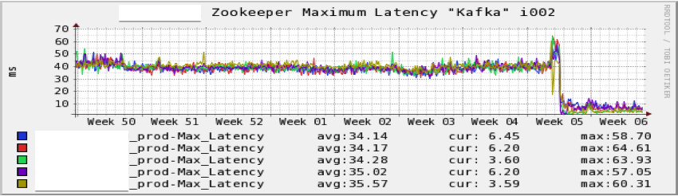
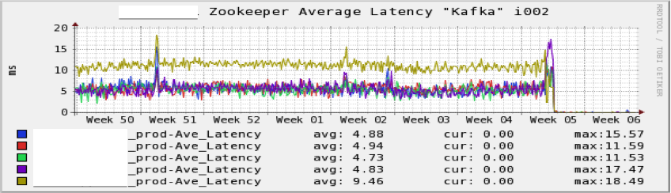
Zookeeper on SSD
Notes:
Since we had issues with overloading zookeeper with our consumers updating offset information every minute, we reduced the offset commit interval to once every ten minutes. This was less than ideal, it caused our lag monitoring to be very unstable. Depending on the time of day the number of messages received during a 10 minute interval could easily exceed our thresholds thus triggering alarms. We decided to try out using SSDs for our transaction logs. The results are amazing. The average latency went to zero and we had to double check to make sure the cluster was still working.

Slide 23
Monitoring
Notes:
Kafka is used to monitor the health of every server and application, so it’s critical that we assure that it’s working properly at all times.
With so many producers and consumers of data, and almost every critical piece of data moving through Kafka, we constantly hear…

Slide 24

Kafka Is Broken!
Notes:
Kafka is broken!
Anyone with small girls knows that Pinkie Pie is always so happy! She loves Kafka because it moves all of her data around.
But she’s so mad at us now because something’s not working right
How did this happen?

Slide 25
Kafka Is Broken!
Everything is Kafka’s fault first
What is lag?
Consumer Problems
Application problems
Kafka client problems
Notes:
It’s normal for people to want to blame something outside of their own system for their problems first, and Kafka is an easy target. Any alert that has “Kafka” in the title can quickly become a call to us
Most of the time, however, the problem is on the application side. The most common of those problems is consumer lag, which is poorly understood by many users.
Lag is the difference between where a consumer is for a partition (known as the consumer offset) and the head of the partition (also called the broker offset)
Consumers have problems with lag for many reasons
On the application side, they could have excessive garbage collection, or a problem with their processing logic, or it could just take a long time to process messages
But it could also be a problem in the Kafka consumer, which becomes more of the Kafka team’s problem. This could be things like a rebalance because the cluster has changed, a connection problem, or even a bug

Slide 26
How Do We Sleep At Night?
Educating Users
Why lag is their fault
Monitoring the Ecosystem
Kafka Brokers
Zookeeper
Mirror Makers
Audit
REST Interfaces
Week Over Week
Notes:
How do we avoid getting woken up at 3 AM when there’s a problem?
One of the most important things is to educate the Kafka users. Our users are not Kafka experts – they are experts in their own applications, and that application happens to interface with Kafka. So it is up to us to make sure they have the information they need to operate smoothly. When the users understand how lag happens, they know to look for telltale problems in their own applications, like excessive GC times, consumer rebalancing, or stuck threads. We help them with this, often investigating the error messages to help them pin down the problems.
Outside of that, we monitor the entire ecosystem of components that make up Kafka
This includes, of course, the brokers themselves
We’re also responsible for all installations of Zookeeper, both the ones the underpin Kafka and the instances that support other applications
Mirror Maker is the piece that is responsible for replicating messages between clusters
We have an audit infrastructure that measures topic completeness and load times
And we have RESTful interfaces to Kafka for producers and consumers that do not use the Java packages
One of the best tools is to compare everything week over week. If the same spike in a metric happened last week, and the week before, there’s a good chance it’s normal. It can also indicate a performance problem at peak operation. And we can easily see when message traffic is trending upwards over time, and plan for expansions to match.

Slide 27
Cluster Health and Utilization
Under replicated partitions
Offline partitions
Broker partition count
Data size on disk
Leader partition count
Network utilization
Notes:
We monitor many metrics for each of our components.
On the Kafka brokers, one of them trumps all others, and that is the under replicated partition count. A number of brokers in the cluster reporting a high and steady count usually indicates that a broker has gone offline. A quick count of one or two that goes away often indicates a traffic spike or a problem due to load. If this number is not zero, you’re working without a safety net. We also monitor the offline partition count, but if it is ever not zero, it’s already too late. If partitions are offline, we are losing data.
For utlization, there are several numbers we look at. The broker partitions count is the number of partitions (either as a leader or a follower) that each broker manages. We want this to be close to equal across all the brokers, but it’s not that simple because we also need to look at the data size of partitions on disk. Some topics are busier than others, so they have higher disk utilization. We need to strike a balance between the two numbers.
We also watch the leader partition count. Ideally, we want all of the brokers to be the leader for the same number of partitions. This assures that load is balanced across the cluster. If it’s not even, we probably need to run a preferred replica election. Lastly, we’re also monitoring the network utilization, both the raw interface statistics and what Kafka is reporting for bytes in and bytes out. We want a smooth curve, with no unexpected dips and spikes.

Slide 28
Zookeeper
Ensemble availability
Latency
Outstanding requests
Notes:
Everything depends on Kafka, and Kafka depends on Zookeeper. In general, Zookeeper is a much simpler system, and so requires less active monitoring. Since we moved to solid state disks, the performance is not even a concern.
The primary metric is the availability of the servers in the Zookeeper ensemble. If a server goes offline, or if two servers believe they are leader, we know there’s a problem to take care of.
We also monitor the average latency of requests. Lately, it’s always zero, but more than 20 or 25 milliseconds could start to cause problems. In part, this is because Zookeeper processes requests in serial, so each request delays the ones behind it. This is why we also monitor the number of outstanding requests. If the number starts to climb, it means that Zookeeper is being slow answering requests and we need to find out why.

Slide 29
Mirror Maker and Audit
Producer
Mirror Maker
Lag
Dropped Messages
Audit Consumer
Lag
Completeness check
Audit UI
Message
Counts
Messages
Cluster
MM
Cluster
All
Messages
Audit
State
Audit
Consumer
Audit
Consumer
Audit
State
Audit
UI
Notes:
Mirror Maker is the tool used for replicating messages from one cluster to another. With over 20 clusters, we run a lot of these, and they’re a critical component in the data pipelines that serve offline processing. Mirror maker sits between two clusters, consuming all messages from the first and producing them to the second. One of the best metrics for us to monitor here is lag. I know I said that lag is a user problem, but in this case, mirror maker is the user. The lag metric tells us how far behind mirroring is.
We also monitor dropped messages. Any increase over zero is unacceptable, as that means that we are losing data in our pipelines that serve monitoring and offline processing. This can happen if the mirror maker consumer is working, but the producer side fails for some reason (such as a misconfiguration or extended network problem)
Audit is a custom system that we have put in place at LinkedIn to monitor the completeness and the latency of our data pipelines.
Each of our producers also produces information in separate messages about how many messages were produced.
Each tier has an audit consumer that reads all messages in the cluster and uses this information to determine if that tier has seen all of the messages that were produced upstream.
It also measure how long the messages took to get there. Again, because the audit consumer is a consumer, we monitor the lag.
The other piece of audit is the UI. This is responsible for reading all of the information the audit consumers produced and providing it in an easy to consume format.
For audit, we also measure the lag. Do you see a pattern here? All consumers should monitor their own lag. If we have a problem with audit, and the audit consumer is lagging, it’s probably not an issue with actual data flow
We also have a separate alert that goes out if completeness at any tier for a monitored topic is anything except 100 percent
In addition to the metrics, we have a web UI for audit that can show the completeness and latency in the pipeline for any topic at any time
----- Meeting Notes (3/12/14 13:17) -----
May be useful to show the topic graph here from the UI
Just don't show a topic name

Slide 30
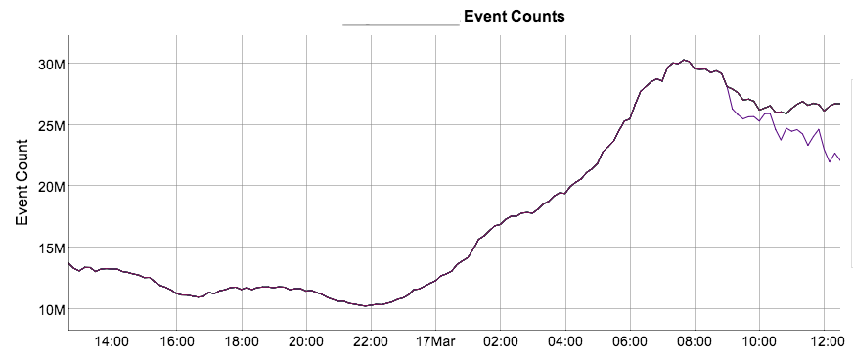
Audit UI
Notes:
The audit UI is a web application that shows a graph for each topic over time with information on the completeness of the topic. In this graph, we can see that for this topic, one of the tiers started reporting fewer events around 9:00 AM. This is actually a situation we’re aware of, and it’s due to performance issues on that particular broker and mirror makers. It catches up later in the day.

Slide 31
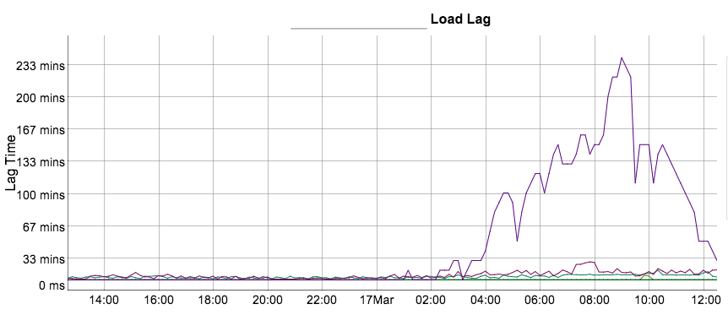
Audit UI
Notes:
The Audit UI also shows a graph for how long it took each tier to receive messages. These times get higher for each tier further away from the producer. Here, we can see that the same tier that is showing fewer messages is showing a very high load time that started increasing several hours before completeness dropped, and has been dropping since then..

Slide 32
Tuning
Notes:
Now that we are monitoring Kafka, we can tune it for ideal performance.
The application itself is quite efficient at what it does, so what is left for us is to provide the best environment for it to work in.
This means tuning the hardware, operating system, and the Java environment.

Slide 33
Hardware and OS
Kernel Tuning
Swapping is Death
Allow more dirty pages
Allow less dirty cache
Disk throughput
More spindles
Longer commit interval
Notes:
- As with almost any application, swapping is one of the worst things that can happen to us.
All of our brokers have swappiness set to zero. We also avoid running other applications on the kafka brokers to decrease contention for resources
We also tune the kernel to allow more dirty pages, and allow longer intervals between forced flushes
But we allow less dirty cache memory
On the hardware side, the most important thing is to have a lot of disk throughput available for Kafka.
To accomplish this, we make sure we have dedicated disk for Kafka data, and spread it out over as many spindles as possible. We use a RAID 10 configuration over 14 disks.
We increase the commit interval for this mount point. Because we’re replicating data out to multiple brokers, we’re willing to tolerate the risk that comes with a system crash
----- Meeting Notes (3/12/14 13:17) -----
Put the tuning in the speaker notes

Slide 34
Java Virtual Machine
Notes:
The other side of the environment is Java, and when we’re talking about tuning Java, of course we really mean

Slide 35
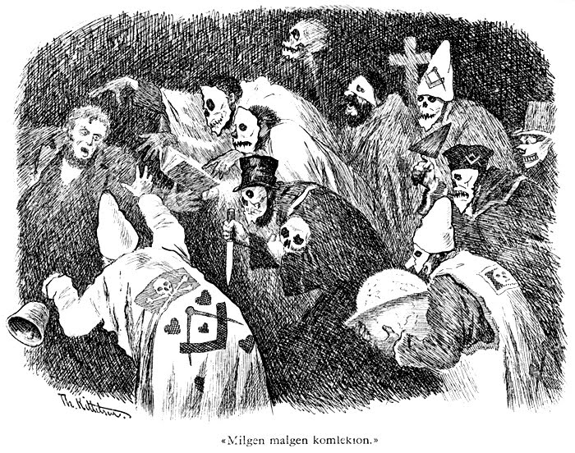
Garbage Collection
Notes:
Garbage collection. To most, this is a dark art that requires
Archaic knowledge and sacrificing small animals.
We could spend hours talking about and not even scratch the surface, but in this case we can make it a lot easier.

Slide 36
Garbage Collection
Java 7, update 51
Garbage First (G1) Collector
Set the heap size
Specify a target GC pause time
Don’t set the New size
GC Times
Less than 15ms per second in GC
Steady 20-22ms GC intervals
Almost no full GC cycles (and only 200-400ms when it does)
Notes:
The first step is that you should run JDK 7. Specifically, update 51. We tested update 21 for a while, and it still had significant bugs, but update 51 has been performing well.
In addition to other improvements in the JVM, this gives us
The G1 Collector. If you haven’t looked into this yet, you’re going to be pleasantly surprised.
The goal with G1 is to provide consistent GC intervals, and to do so with a minimum of tuning. For many applications, it takes the pain out of tuning Java.
For the most part, you are able to set the size of your heap
Then designate your desired GC pause time in milliseconds, which is the length of time you would like most of your GCs to be
Importantly, do not set the New size, or ratio. If you do, it overrides the pause time target.
G1 will then do its best to meet the goal you specified. It’s not a guarantee, and you need to tune the target to get it in the right range for your application.
For Kafka brokers, we have been able to reduce the total time spent in GC by an order of magnitude from JDK 6
We also have a steady, predictable GC interval of 20 to 22 milliseconds for each young GC
We also have virtually eliminated full GCs. The only time we will see a full GC is if there is a load spike on a cluster, and it is generally only one, and then back to normal.
----- Meeting Notes (3/12/14 13:17) -----
Add percentage of CPU time in GC

Slide 37
Closing

Slide 38
What’s Coming in 0.8.2
Consumer offsets in the broker
Delete topic
Further down the road
New producer
Improved producer API
Notes:
Kafka 0.8.1 is now out, and we are looking forwards to the next version. In 0.8.2, we are going to see
Consumer offsets are going to be moved out of Zookeeper, and into the broker. This will ease the strain on Zookeeper and also makes sure all of the offsets are canonical in the same place
We are also getting support for deleting topics from a cluster.
Further down the road, and available in beta, there is a new producer coming. It will provide throughput improvements over the current producer

Slide 39
Upcoming Operational Work
Learning to share
Shrinking a cluster
Cluster comparison
Advanced monitoring
Notes:
On the operational side of Kafka, we have no end of projects to work on. A few of the big ones are
Learning to share. The tools that we have developed around QoS and cluster balancing have some dependencies on internal systems at LinkedIn. We’re working on decoupling those so we can contribute the tools back to the Apache project
We are going to expand the cluster balance script to provide for shrinking a cluster by removing all partitions from a broker so it can be safely shut down
With so many cluster, discrepancies between cluster and topic configurations are inevitable. We are starting work on a tool to examine two clusters and show all of the differences between them
We also continue to improve our monitoring systems
We are developing dashboards for Zookeeper, Kafka brokers, and Kafka mirror makers to provide easier access to the metrics
And along the lines of comparing metrics week over week, we want to be able to more easily identify usage trends over time to make planning much simpler

Slide 40
How Can You Get Involved?
http://kafka.apache.org
Join the mailing lists
users@kafka.apache.org
irc.freenode.net - #apache-kafka
Contribute tools
Notes:
So how can you get more involved in the Kafka community?
The most obvious answer is to go apache.kafka.org. From there you can
Join the mailing lists, either on the development or the user side
You can also dive into the source repository, and work on and contribute your own tools back.
Kafka may be young, but it’s a critical piece of data infrastructure for many of us.

Slide 41
Talk To Us
Kafka SREs at LinkedIn
Clark Haskins
https://www.linkedin.com/in/clarkhaskins
chaskins@linkedin.com
Todd Palino
https://www.linkedin.com/in/toddpalino
tpalino@linkedin.com
Notes:
We’ll take some time now to answer any questions you have, but you can also contact us with any you have later. We’re always happy to answer questions.
We both read and respond on the Kafka users mailing list.
You can also contact us directly.

Slide 42
Questions

